Slide 1


Organisation and Time Mangement Skills
GP Enhanced Trainee Support Programme

Slide 2
Learning Objectives
Understand the reasons why lack of organisation skills will lead to problems with GP training
Learn some of the techniques used to improve your time management
Apply some of these techniques to your working week and become more efficient
Be successful in your GP training journey

Slide 3

Docman
Referrals
Tasks
Emails, emails, emails
Tutorials and teaching preparation
Eportfolio log entries
ESR Prep
QIP
MSF
Surgeries & home visits
10/15/20 minute appointments
Life admin
Housework
Meal prep
Childcare
AKT preparation
SCA preparation
This Photo by Unknown Author is licensed under CC BY-SA
Out of hours rota

Slide 4
Reasons why...
  Lack of information
  Inexperience
  Feeling overwhelmed leading to lack of motivation
  Unfamiliar with IT systems
  Perfectionist
  Ill health
  Easily distracted

Slide 5
Group work
Have a chat in your small groups about how we might work through some of these issues

Slide 6

Eat that frog !
Mark Twain
'' if you eat a live frog at the beginning of the day that will be the worst thing you have to do all day ''

Slide 7


Slide 8
Do the biggest/hardest/most important task first
Start immediately...don't procrastinate
Develop a positive addiction to completing tasks
Practice one frog at a time

Slide 9
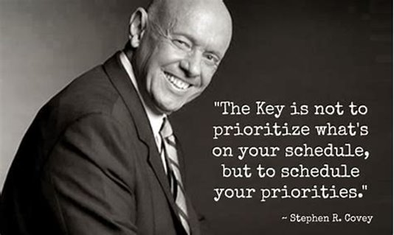


Slide 10
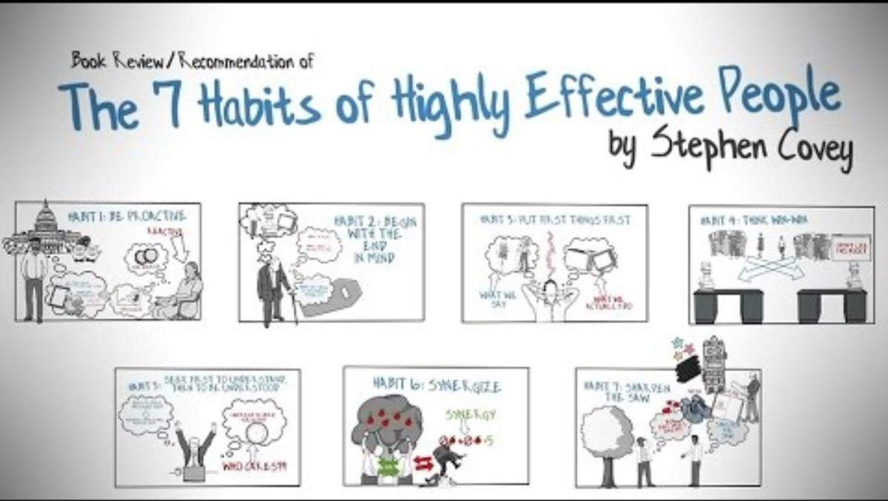

Slide 11
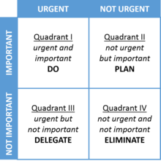
Look at urgent/non urgent and important/not important things
Put time aside for important and urgent things
Learn to delegate
Look at the week/bigger
picture

Slide 12
Group work
GPST trainee on a Sunday morning. Parents are coming round for Sunday lunch that afternoon and needs to shop and cook for this. After Sunday lunch, you have already said yes to drinks at the neighbour's house. You don't really know them well but felt it was polite to accept the invite. ESR is the week after next and still have 3 outstanding CCRs to complete, and self rating to do prior to ESR. ES is going to be on holiday next week and doing ESR the first day back. You have to pick a topic for your tutorial this week with your CS. You have an OOH shift booked for tomorrow night and you also have your running club on this week. The grass needs cutting and the car also needs an MOT in the next few weeks. It is also your partner's birthday this week and you have not planned anything yet (or even bought a present yet...)

Slide 13
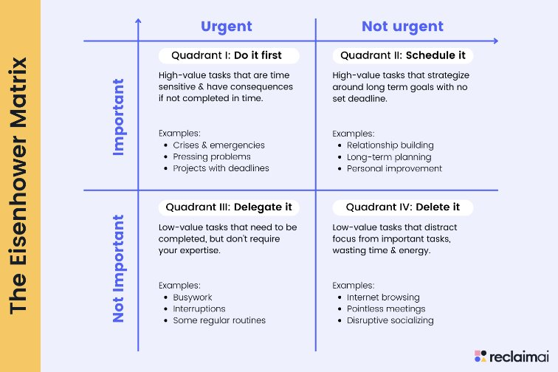

Slide 14

Ed Pooley book, online course
BMJ emodule - Workload and Time Mangement
workload & time management - Bradford VTS

Slide 15
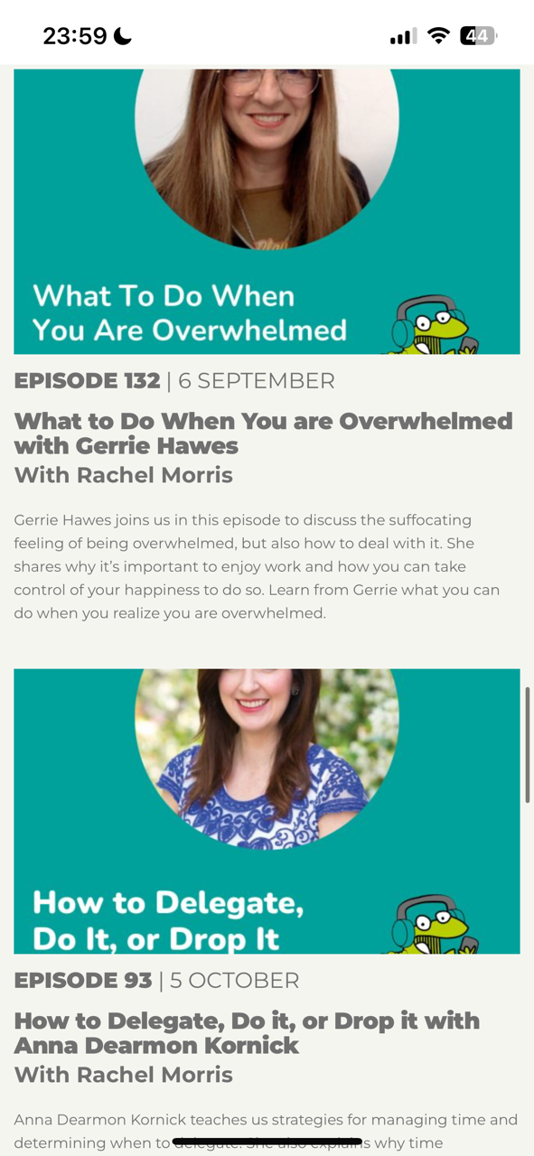
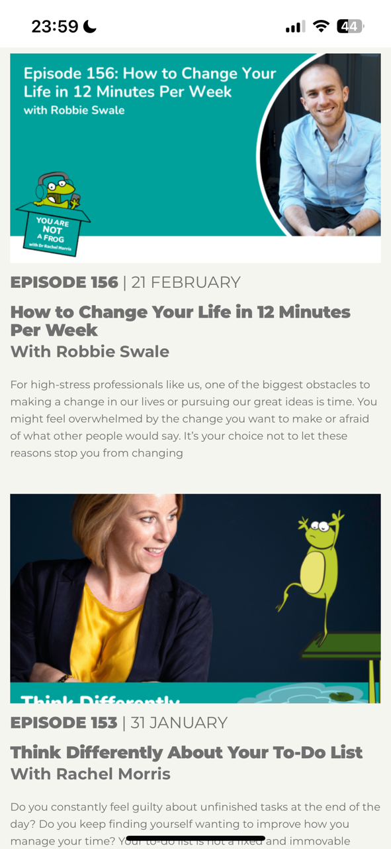
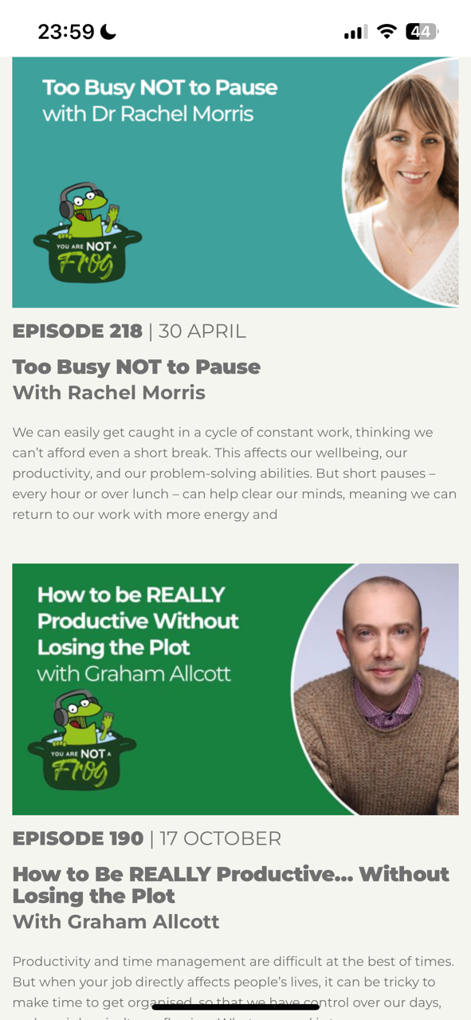
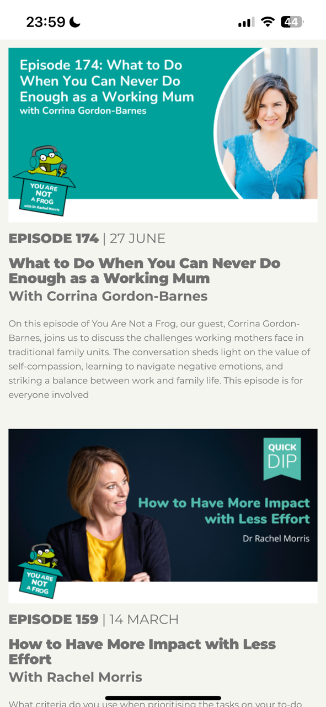
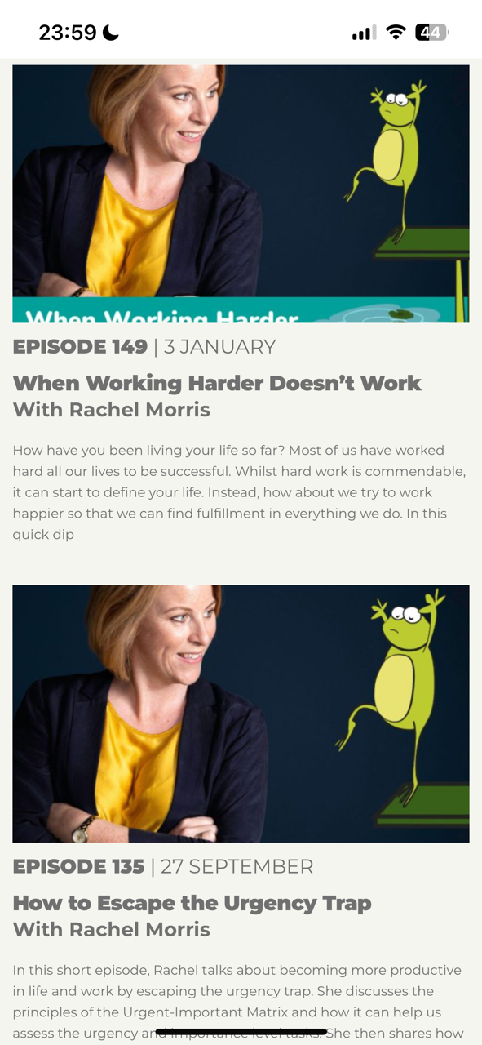
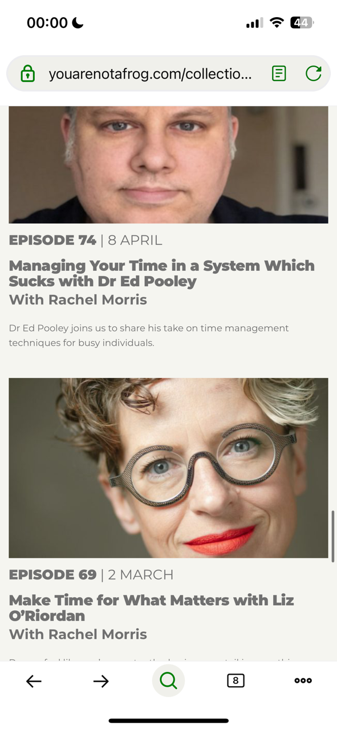

Slide 16

Thanks for listening...
Any questions?

